Slide 1
Lean Laboratory Capability Process Proposal
Jim Oates
31 October 2013

Slide 2
Problem Statement
The current Laboratory Capabilities Process is not being maintained. The process is perceived as overly complex and lacking in value.
As a result, UL cannot provide an accurate laboratory capabilities list as required by our accreditors. Process non-conformances have been documented in CAR 133911863.

Slide 3
Problem Statement – CAR 133911863
The current Laboratory Capabilities Process is not being maintained. The process is perceived as overly complex and lacking in value.
CAR 133911863: “The scope of laboratory testing capabilities is not being maintained accurately”.
Review of lab scope maintained per 00-LO-S0408 against lab projects in LPM.
Of the standards associated with completed LPM projects many standards (or tests if added after June 1 2008) were not found in the Lab scope of capability in KMS
Non-compliances found in: Melville NY, Plano TX, Vadnais Heights MN, RTP, Brea CA, Toronto Canada, Camas WA, Bangalore India, Singapore, Korea, Guangzhou China, Hong Kong, Denmark, Poland, Milan Italy, and Frankfurt Germany.

Slide 4
Problem Statement – Survey and Feedback
The current Laboratory Capabilities Process is not being maintained. The process is perceived as overly complex and lacking in value.
Survey results show:
Most people have at least a high level understanding of the current process.
“must be simplified or obsoleted”
Most people think it is not easy to add lab capabilities using the current process. Comments:
“The process takes very long time and it does support the business timelines”
“too complicated and unnecessary”
Most people (9 out of 14) know the difference between a Scope of Accreditation and Lab Capabilities.
Other feedback from stakeholders:
“If the process can be simplified, we should be able to get more location using it. Feedback I have gotten is that the process is tedious and cumbersome. It’s a lot of work to get all the supporting documents together, especially for tests that they have done a long time ago, but didn’t get it on the list.”
“Lab management team did not see the value for complying the SOP requirement. (Maybe is because of they did not understand or familiar with the ISO 17025 requirement)”
“Lab work assignments...by global engineering are generally based on their existing knowledge of basic testing capabilities, not based on the list of specific tests described in the Lab Scope of Capabilities spreadsheet.”
“Attitude of dealing with it later if auditors locate problem - rather deal with it later as a CAR (short term gain - easier to ask for forgiveness than permission)”

Slide 5
Proposal for Lab Capabilities
Premise:
a) The Laboratory has specific policies/processes in place for ensuring the competency of staff, accommodations/environmental conditions, and equipment. Staff competency includes demonstrations of their ability to read and follow test methods.
b) Current Certification Process includes a review by a qualified engineer.
See 00-OP-S0044 Project Handling Process and 00-OP-J0036 Preliminary and Final Review Job Aid for UL/C-UL/ULC Mark Programs.
These describe verification of CCN, qualifications, appropriate equipment used, appropriate tests, passing tests, test methods match revision of standard, and compliance to applicable UL policies and processes.
Therefore: We can leverage our existing product safety certification policies and processes as the means for an independent review of projects used to add standards to our laboratory capabilities list.
The Laboratories Capabilities List simply becomes a list of standards by site where work was performed over a fixed period of time, assumed to be 2 years.

Slide 6
Proposal for Lab Capabilities
The successful completion of a review by a qualified Engineer adds that location’s capability for that standard.
A report can be generated showing work in each standard by site over the past two years. This report is the Capability List.
If no work is done to a standard in two years, it ‘falls off’ the list.
To regain ‘capability’ for a standard, work for that standard is directed to the lab, that work is successfully reviewed, and that capability is again included on the Capabilities List.
Standards in the accreditation TO Lab scope are also included in UL’s capabilities, even if we have not tested to these standards in two years.

Slide 7
Lab Capability is determined by:
Lab staff are qualified:
00-TC-G0050 Technical Competency Requirements for Evaluation Staff - Laboratory
Lab Environmental Conditions and Accommodation are satisfied:
00-LC-P0025 Global Laboratory Accommodation and Environmental Conditions Policy
Calibrated and maintained equipment was used in the Lab:
00-LC-P0031 Global Laboratory Equipment Policy
Per this proposal: A certification project successfully completes the process through that laboratory, thereby demonstrating the capabilities.

Slide 8
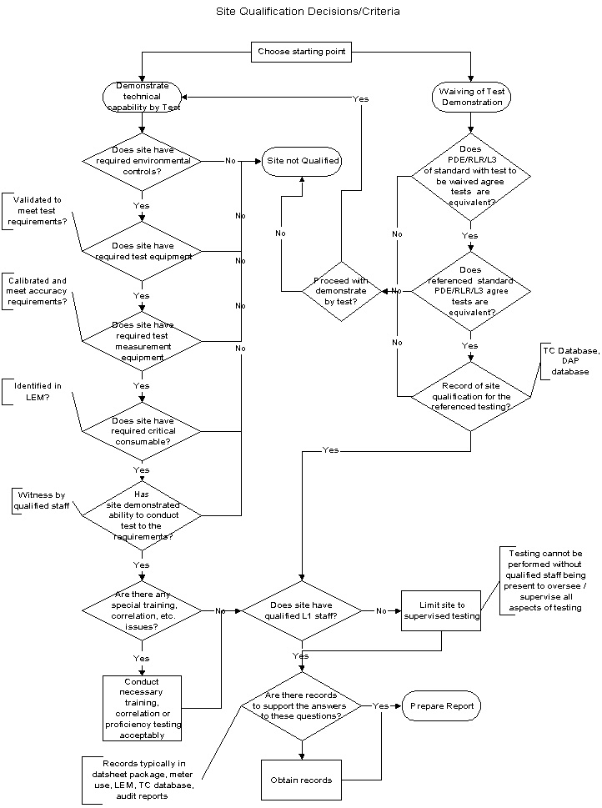
Job sent to Lab by Engineering
No additional work is needed to maintain the Capabilities list or create and store other records.
Lab performs tests, completes datasheet, returns package to Engineer
Job Reviewed by Engineer.
Review completed. Standard now appears in the capability report
Current Lab Capability Process
Requires separate review of test environment, equipment, consumables, demonstration of ability to perform tests.
Requires preparation of a form and a report and an approval.
Separate parallel independent process from that used for other work.
Maintenance of the list has been problematic.
Proposed Lab Capability Process
Leverages off of UL’s existing certification process – no forms, reports, approvals beyond that done for any certification project.
No action required by Lab Managers – Completed project records serve as the Lab Capability list.
No maintenance, no findings.

Slide 9
Scope of the Capabilities Proposal
The Laboratory Capability Process includes horizontal and vertical labs where Product Safety Certification work is done.
Includes work done in Product Safety tools (LPM or LIMs).
Out of scope: Non-certification work, non-Product Safety business.

Slide 10
Proposal Stakeholder Review
Quality
Accreditation Services
North American Certification Programs Office
Partnered with Ray Burg (North America Laboratory Director)
Series of meetings with Lab Operations in EULA, Asia, North America
Collected feedback to refine proposal
Discussions to ensure SNAP requirements are met

Slide 11
Results of the Stakeholder Feedback
Compliant to ISO 17025 Requirements
Compliant to ISO Guide 65 Requirements
Compliant to CAN-P-1501A Requirements
Compliant to ISO 17065 Requirements
Compliant to CAN-P-1500 Requirements
Meets UL’s needs

Slide 12
Proposal Implementation
Ray Burg’s Team
Discussions to ensure SNAP requirements are met
Drafted SOP changes
Report Creation – Two paths
Jim Kurtz report via Datamart
Infosys ‘resolver team’

Slide 13
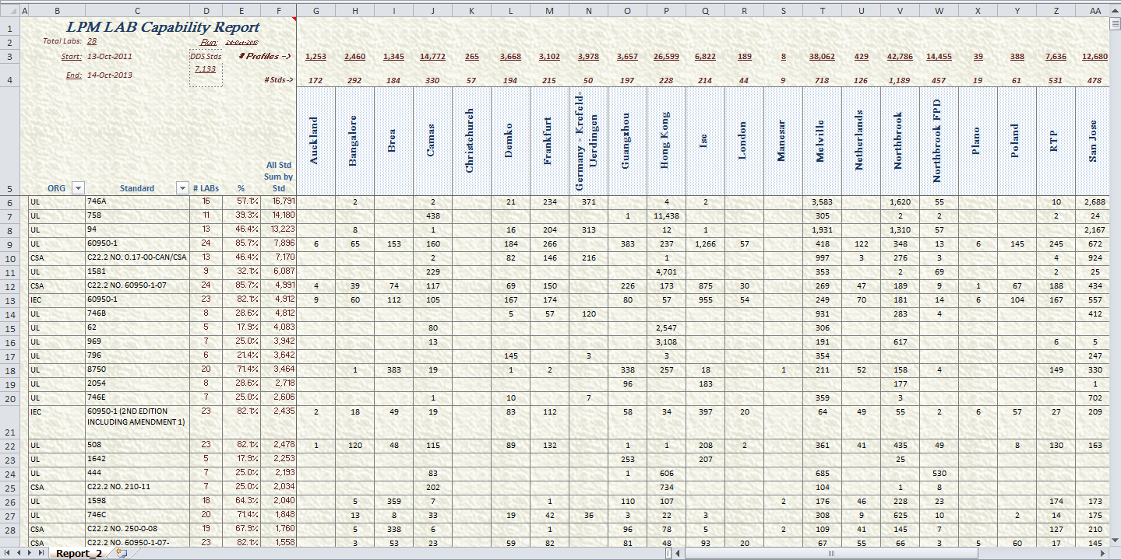
Laboratory Capability List (created by Jim Kurtz)
This shows the number of projects completed at each site by standard. The LPM Standard field is searched for all standards listed in DDS. This is done in Excel using Datamart.

Slide 14
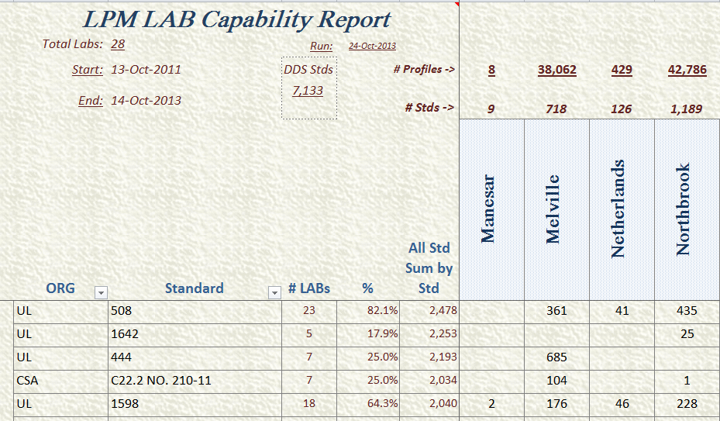
Capability List Details
Number of LPM profiles searched for that location
Start and End Dates of Report
Number of DDS standards searched
Number of standards found at that lab
Total number of projects for that standard
Percent of UL labs doing work in this standard.
Number of labs that have done work in the standard
Number of projects with that standard

Slide 15
Future Enhancements and Next Steps
Process documents are being revised to incorporate this new Capability philosophy (Bob Florczyk)
00-LC-S0370 Product Safety Business – Laboratory Testing Capability
00-LO-S0408 UL Mark Scheme - Laboratory Site Qualification
Report will be done in OBI – improved speed, and mitigation if Datamart is discontinued at year’s end (Jim Kurtz or IT).
LIMs information will be accessed via OBI, and capability report will be developed for that data (Jim Kurtz or IT).

Slide 16
This proposal. . .
. . . does
show a list of standards where laboratories demonstrated their capability by performing at least one test in that standard.
show the number of jobs done per standard.
allow for a capabilities list from both LPM or LIMs.
. . .does not
show laboratory capabilities by test.
prevent a lab from taking on work they do not have the capability to perform.
directly show labs that have had capability removed.
show all manually-entered standards where there are typos or non-standard text entry.
account for work done outside of LPM or LIMs.

Slide 17
THANK YOU.

